Slide 1
Unocal Case Presentation
Preksha Agarwal | Satyen Amonkar | Shivanshi Bajpai | Tanaya Hirlekar Kripesh Jain | Spiti Sawant | Aditya Shettigar

Slide 2
History
1850s
1859
1880s
1887
1922-1997
Lyman Stewart, Pioneer of Unocal, starts looking for oil in NW Pennsylvania
Oil wasn’t used for many purposes due to its odour and limited forms
Oil business boomed when realized it could be refined into kerosene
Stewart starts working full time in the oil business
After modest success, decides to move to California, as oil business was in its infancy
Stewart and Hardison finds a gusher after multiple failed efforts.
Stewart and Hardison partnership merges with two oil ventures, forms as Union Oil Co. of California.
Failed attempt by Royal Dutch
Company, fear of foreign ownership of oil. Company sells its refining and marketing businesses to renew focus on exploration and production.
Notes:
Lyman Stewart, Pioneer of Unocal, starts sniffing gopher holes in NW Pennsylvania during 1850s.
Oil wasn’t used for many purposes due to its odour and limited forms
Oil business boomed when realized oil could be refined into kerosene
Stewart starts working full time in the oil business
After modest success, he gets tired of the competition in Pennsylvania
Decides to move to California, as oil business was in its infancy
Stewart and Hardison finds a gusher after multiple failed efforts.
Stewart and Hardison partnership merges with two oil ventures, forms as Union Oil Co. of California.
Multiple attempts of British ownership were took off due to the fear of foreign ownership over oil.
Company sells its refining and marketing businesses to renew focus on exploration and production.

Slide 3
Unocal in 2000s
Unocal became world’s largest investor-owned oil and gas exploration and production company.
Became the low-cost oil driller in the industry.
California oil properties exhausted or sold
Energy assets only centered around Gulf of Mexico and Far East, with minimal holding in the United States.
60 per cent revenue derived from oil production ad 30 per cent from natural gas.
Unocal was acquired by Chevron for $ 17.9 billion in 2005
Unocal shut its operations in 2005 except for its operations in Asia.
Notes:
Unocal Corporation, originally (1890–1983) Union Oil Company of California, former American petroleum corporation founded in 1890 with the union of three wildcatter companies—the Hardison & Stewart Oil Company, the Sespe Oil Company, and the Torrey Canyon Oil Company.
The founders of the Union Oil Company were Wallace L. Hardison (1850–1909), Lyman Stewart (1840–1923), and Thomas R. Bard (1841–1915), who became the company’s first president and later a U.S. senator (1900–05).

Slide 4
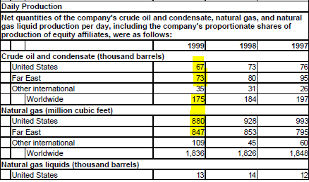
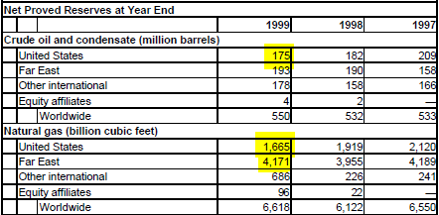

Unocal Proved Reserves and Daily Production
Notes:
Unocal Corporation, originally (1890–1983) Union Oil Company of California, former American petroleum corporation founded in 1890 with the union of three wildcatter companies—the Hardison & Stewart Oil Company, the Sespe Oil Company, and the Torrey Canyon Oil Company.
The founders of the Union Oil Company were Wallace L. Hardison (1850–1909), Lyman Stewart (1840–1923), and Thomas R. Bard (1841–1915), who became the company’s first president and later a U.S. senator (1900–05).

Slide 5
Risks At Unocal
Replacing the factory:
Replacing the factory parts to continue the productivity
Replenishing the oil reserves
Political Risks
Sensitivity Analysis
Incidents (Physical Risk)
Hedging Prices

Slide 6
Replacing the Factory
Replacing the parts to keep the productivity going
Unusual factory type for oil business
Market cost in oil business is dependent mainly on amount of oil that could be possibly extracted
For the continuation of oil and gas production, UNOCAL has to replace the entire factory throughout the year
In case parts are not replaced, the productivity is reduced by ⅓ amount by the end of the year
As UNOCAL’s business relies on volume of the oil extracted, they cannot risk the productivity. Therefore, need to replace the parts regularly

Slide 7
Replacing the Factory
Refilling the reserves
Key success indicator for oil and gas companies is the replenishment of reserves
UNOCAL has to keep looking for new sources of oil to refill their oil reserves
Not all the projects could be pursued by the company. Need to perform the risk-reward analysis between multiple projects and choose that best fit the limited capital and trade-off factors
UNOCAL uses economic analysis software package that performs Monte Carlo analysis to better understand the risk and return attributes of projects

Slide 8
Political Risk
Most of the UNOCAL’s U.S. drilling is offshore, not far from the desirable recreational beach properties
Permission and oversight of the Federal government required
UNOCAL’s Far East operations highly dependent on the goodwill of the co-operative government
Less/ No support from the government bodies pose greater risks for the company operations making Political Risk a significant factor

Slide 9
Sensitivity Analysis
Oil prices and drilling success rate have a highly significant impact on UNOCAL’s earnings.
A $1 change in the worldwide oil prices per barrel impacts in $33M change in the net income and a change of $0.14 on the earnings per share.
A 10% change in the exploratory drilling success would impact in $27M in the net income and $0.11 on the earning per share.
As the oil prices and the drilling success rate are uncertain, UNOCAL faces significant income exposures to these two factors.

Slide 10
Incidents (Physical Risk)
Accidents are termed as ‘Incidents’
Complex and dangerous industry
Accidents can cause environmental damage, human casualties, severe property damage or shoreline contamination
Industry nightmare and petroleum fires at UNOCAL
In April 1926, UNOCAL became a victim of double calamity
Ignited 4 one-million barrel reservoir in San Luis Obispo, California
A day later from the same storm struck another company tank farm in Brea, California
Total, eight million barrels of oil were destroyed (the equivalent of one-eighth of Unocal’s 1999 production).
Greatest fire loss since the San Francisco fire of 1906

Slide 11
Incidents (Physical Risk)
UNOCAL may be a low-cost oil driller, but has never compromised safety
D. J. Ponville(Spirit Energy 76 drilling manager) says that “We will risk dollars but not people”

Slide 12
Hedging Prices
Hedge is used to surround or protect something
In Investment, Hedging is using instruments in the market to offset the risk of any adverse price movements. In other words, investors hedge one investment by making another.
UNOCAL sells out its oil and gas output as soon as it is produced
It uses Futures contracts, swaps and options, and other hydrocarbon derivative financial instruments to hedge exposure to price fluctuations
Oil selling price went from $17.71 per barrel in 1997 to $11.67 per barrel in 1998 to $15.38 per barrel in 1999
Use of derivatives limited the company’s ability to enjoy price upswings (derivatives: A contract between parties whose value is based on underlying financial assets)

Slide 13
Origins of Enterprise Wide Risk Management
Three circumstance together lead to the formation of Enterprise Wide Risk Management:
Karl Primm becoming head of internal audit of Unocal swiftly made it’s internal audit approach more risk based.
Company maturing beyond its existing compliance focused Health, environment and safety audit program (HES), known informally as the “800 Questions”.
Tim Ling arriving as CFO from McKinsey and Company, where he had worked as a consultant with Unocal management for seven years.
Notes:
Unocal Corporation, originally (1890–1983) Union Oil Company of California, former American petroleum corporation founded in 1890 with the union of three wildcatter companies—the Hardison & Stewart Oil Company, the Sespe Oil Company, and the Torrey Canyon Oil Company.
The founders of the Union Oil Company were Wallace L. Hardison (1850–1909), Lyman Stewart (1840–1923), and Thomas R. Bard (1841–1915), who became the company’s first president and later a U.S. senator (1900–05).

Slide 14
Internal Audit
When Karl primm became head of internal audit, Unocal had 1500 audit units.
When audit managers did risk ratings and looked at audits of previous three or four years,it was discovered that they weren’t hitting any of problems and riskier areas.
Primm recognized that the internal audit department he inherited was less than effective because it ignored most of the fundamental business risks facing Unocal and concentrated on examining whether traditional controls such as segregation of duties were being followed.
Internal audit was not spending its resources well, and Unocal was getting very little return on this investment.
Notes:
Unocal Corporation, originally (1890–1983) Union Oil Company of California, former American petroleum corporation founded in 1890 with the union of three wildcatter companies—the Hardison & Stewart Oil Company, the Sespe Oil Company, and the Torrey Canyon Oil Company.
The founders of the Union Oil Company were Wallace L. Hardison (1850–1909), Lyman Stewart (1840–1923), and Thomas R. Bard (1841–1915), who became the company’s first president and later a U.S. senator (1900–05).

Slide 15
Health, environment and safety audit program (HES)
A problem in implementation at Unocal has been to ensure that the most relevant, up-to-date practices and procedures are being followed as a part of everyday business.
Even after modifying the system for specialized use, HES was strictly compliance based i.e. it appeared as a checkup system prepared to deal with HES auditor’s visit.
An auditor from the HES unit would simply check off yes or no answers for some 800 questions relating to safety and environmental concerns.
Each question was assigned a numerical score, and it was all or nothing as there was no partial credit.
The next step was to devise a plan for cultural shift from checkup system to a culture of concern and attention to environmental and safety issues.
This was done through Operations Management System.
Notes:
Unocal Corporation, originally (1890–1983) Union Oil Company of California, former American petroleum corporation founded in 1890 with the union of three wildcatter companies—the Hardison & Stewart Oil Company, the Sespe Oil Company, and the Torrey Canyon Oil Company.
The founders of the Union Oil Company were Wallace L. Hardison (1850–1909), Lyman Stewart (1840–1923), and Thomas R. Bard (1841–1915), who became the company’s first president and later a U.S. senator (1900–05).

Slide 16
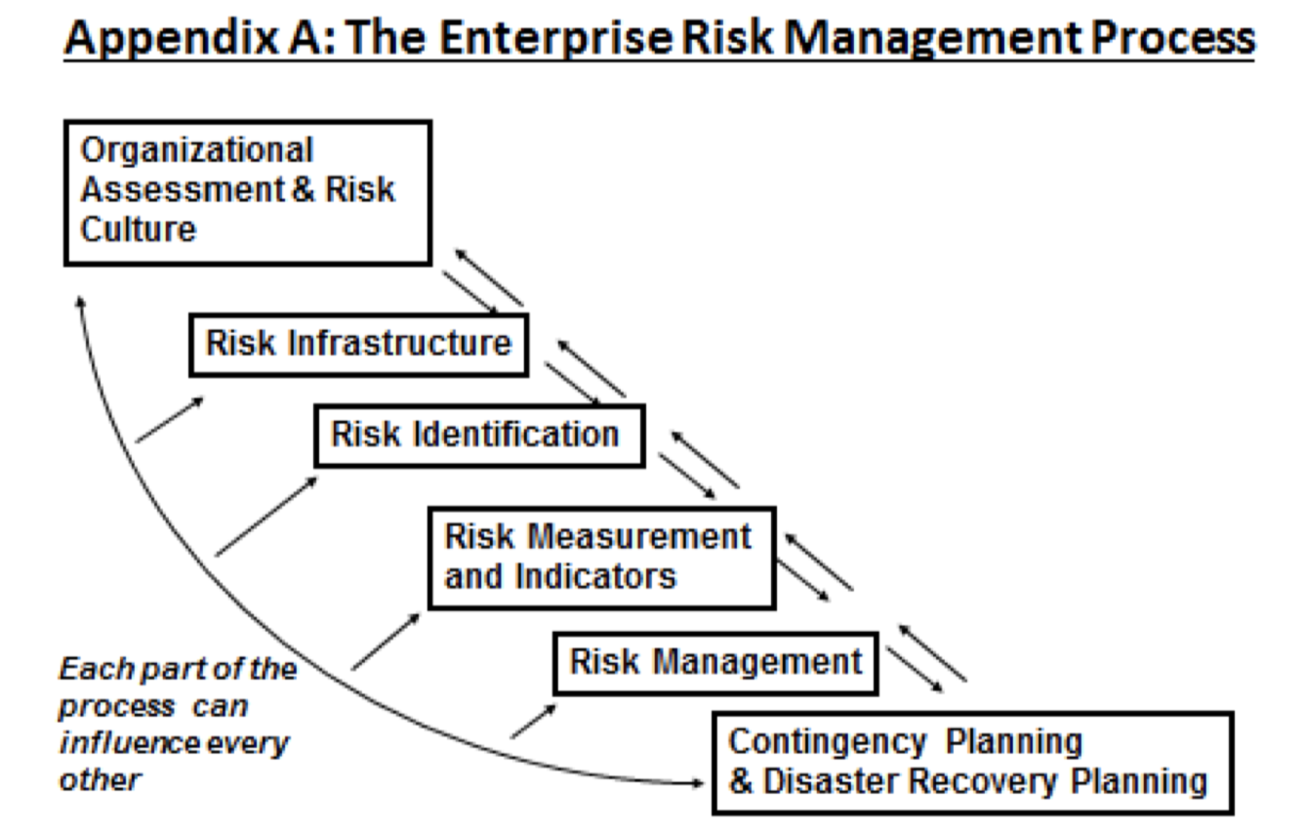
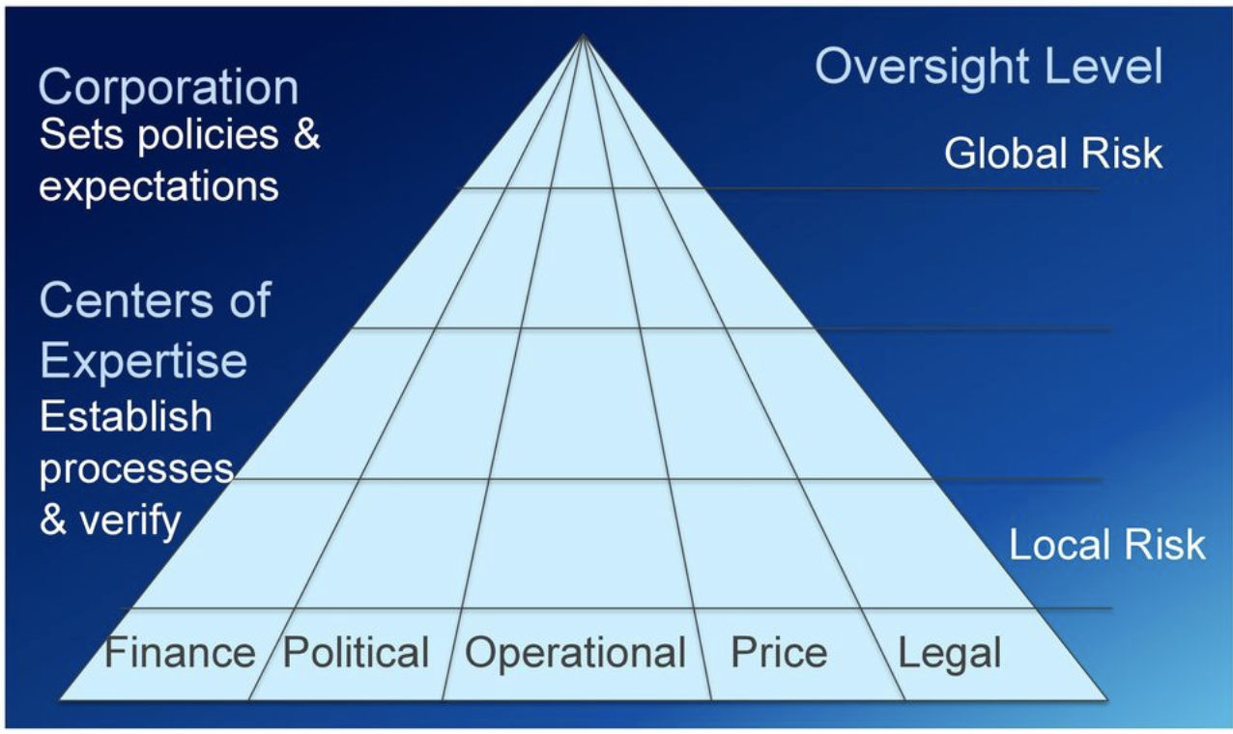
Comparing the ERM Process with Unocal ERM Process

Slide 17
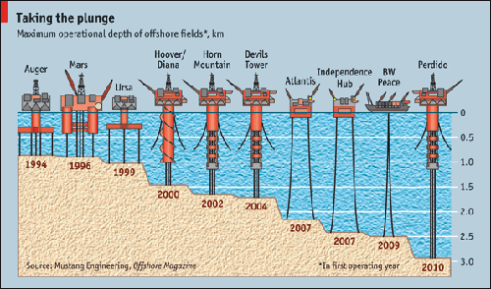
Deep Water Operations
There’s a time-honored principle that oil exploration has in common with the “vote early–vote often” tales of Chicago politics.
It’s a principle that favors companies that enter frontier areas early and drill aggressively.
Late entry generally leads to value destruction.
The industry started in the deep water in the Gulf of Mexico 15 years ago.

Slide 18
As the earth is depleted of its oil, exploration companies must look harder and spend considerably more money to find what remains.
With dwindling resources in the mature fields, the industry is staking a good portion of its future on deepwater exploration, a drag on current reported earnings that carries a whole new array of risks.
Factors that made Deep Water Operations Successful:
Availability of vastly improved seismic data to locate the oil efficiently
Technological improvements to drill deepwater wells and bring the oil to the surface

Slide 19
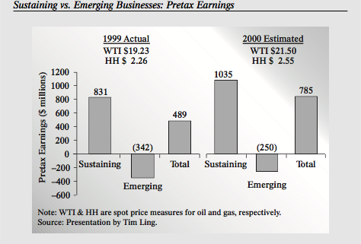
$500 million invested in its deepwater Gulf of Mexico operation.
The impact of deepwater exploration on Unocal’s reported net income is highly significant.
Figure shows that in 1999, sustaining properties such as the Gulf of Mexico shelf generated pretax earnings of
$831 million, while emerging
deepwater business generated
a pretax loss of $342 million.
Year 2000 estimates predict that
the loss on the emerging business
segment will shrink to $250 million,
and Unocal expects this positive trend
to continue.
Why is Deep Water Operations Risky?

Slide 20
Risk Management as culture change
Unocal believes that risk management is a component of good management ,not an adjunct to it, a value it aims to instill throughout its organization.
Unocal aims to instill a philosophy that an overall business risk that can be broken down into component risks, should be managed through an integrated program.
The integrated management of a business risk is possible when line managers understand the company’s objective and how various risks stand in the way of accomplishing these objectives.

Slide 21
Risk Management as culture change
Unocal has not viewed integrated risk management as just another corporate program to be imposed from headquarters.
Focus on “action flows and objectives, not on functions and positions.”
Flexibility in attempting to achieve our longer term goals of a consistent framework and methodology.

Slide 22
Risk Management as culture change
From
Separate types of risk
Multiple mitigation programs
Compliance
Staff-Driven
Audits
To
Business Risk
Integrated business risk management
Commitment
Line-driven
Self-assessment
Risk Objectives - Control = Exposure
Understand Objectives
Understand Risks
Manage
Risks
Acceptable exposure

Slide 23
Critical issues in order of priority
BUSINESS DECISION-MAKING
TECHNOLOGY AND EXPERIENCE
BUSINESS PLAN PROCESS
INFORMATION SYSTEMS STRATEGY
ANALYSTS’ EXPECTATION
JOINT VENTURES/ALLIANCE RELATIONSHIPS
HES EXPOSURE & OMS ACCOUNTABILITY
INTERNAL COMMUNICATIONS

Slide 24
In Summary
Integration of all risk types is business risk.
Business risk must be controlled by understanding business objectives and risk and managing for an acceptable risk profile given required performance levels.
Increasingly, risk management should be considered a line function technology will make this easier and more effective over time.

Slide 25
Conclusion
From its humble beginnings to one of the world’s largest investor-owned oil and gas exploration and production company, Unocal has had to manage the high-stakes risks of finding oil and producing it economically and safely.
But only recently has Unocal embraced the notion that risks should be managed on an integrated, enterprise-wide basis—not left for staff people in various areas to deal with risk by risk.
Notes:
UNOCAL makes sure their production is up and running as it is the heart of the organization’s business.
It also take care of the risk reward factors before choosing a project.
The organization requires political support for their offshore operations.
The origin of enterprise risk management at UNOCAL was driven by the risk management focused officials Karl Primm and Tim Ling who changed the risk environment as soon as they joined UNOCAL. The risk based internal audit helped them discover that they were working with all the low risk units and not high risk.
The continued success and profitability of UNOCAL’s Spirit 76 program in the Gulf of Mexico validated their strategy and created vast opportunities for the company
UNOCAL embraced the notion that risks should be managed on an integrated, enterprise-wide basis and not left for staff to deal with risk by risk, its a line function.
For UNOCAL oil prices and drilling success rate are critical to manage as they directly affect their income.
In April 1926, UNOCAL became a victim of double calamity.
In search of a robust risk system, UNOCAL went with the implementation of Operational Management System.
UNOCAL was the amongst the first to realize to go beyond shallow water drilling.

Slide 26
Conclusion
Risk management is a line function, Unocal management believes, and that means it must permeate everything the company does.
Starting in the internal audit and health, environmental, and safety units, a focus on risk assessment and control is beginning to affect all business units.
A cultural like change this takes time, but Unocal is committed to the effort, and its progress to date is substantial.
Notes:
UNOCAL makes sure their production is up and running as it is the heart of the organization’s business.
It also take care of the risk reward factors before choosing a project.
The organization requires political support for their offshore operations.
The origin of enterprise risk management at UNOCAL was driven by the risk management focused officials Karl Primm and Tim Ling who changed the risk environment as soon as they joined UNOCAL. The risk based internal audit helped them discover that they were working with all the low risk units and not high risk.
The continued success and profitability of UNOCAL’s Spirit 76 program in the Gulf of Mexico validated their strategy and created vast opportunities for the company
UNOCAL embraced the notion that risks should be managed on an integrated, enterprise-wide basis and not left for staff to deal with risk by risk, its a line function.
For UNOCAL oil prices and drilling success rate are critical to manage as they directly affect their income.
In April 1926, UNOCAL became a victim of double calamity.
In search of a robust risk system, UNOCAL went with the implementation of Operational Management System.
UNOCAL was the amongst the first to realize to go beyond shallow water drilling.

Slide 27
Fin

Slide 28
References
Barton T.L.,Shenkir W.G.,Walker .L., (2002) Making-Enterprise-Risk-Management Payoff, Upper Saddle River, New Jersey, Financial Times/ Prentice Hall PTR

